Slide 1

Univ AI1
All in one !!!

Slide 2
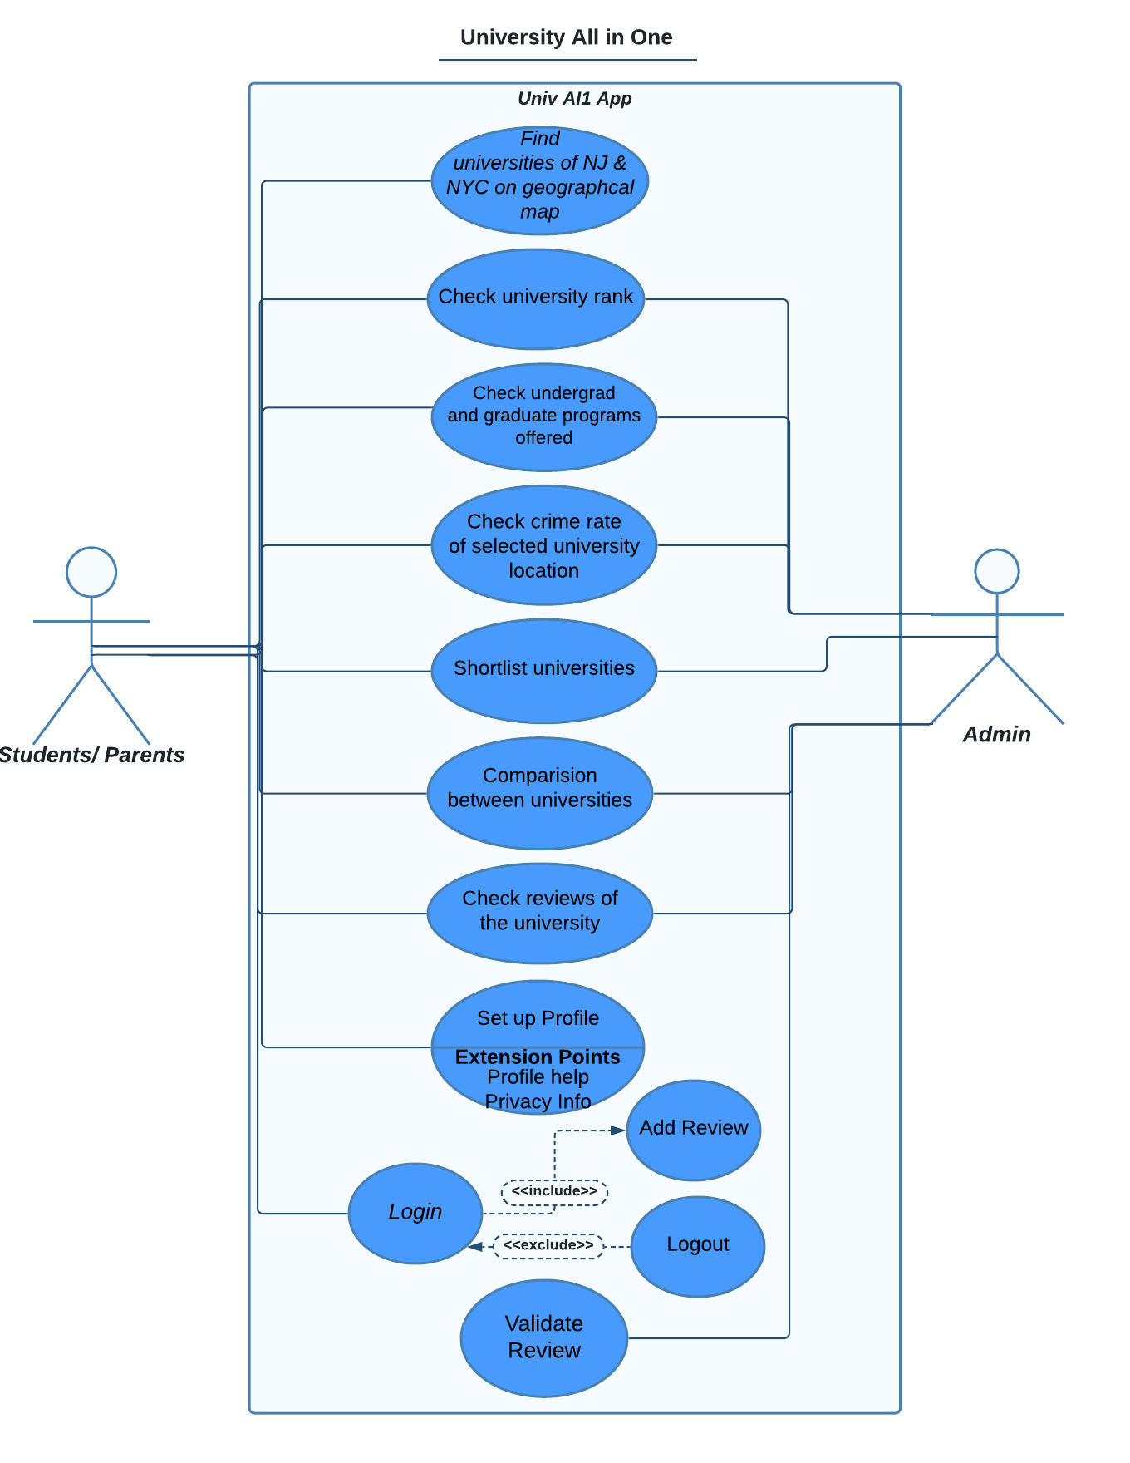
Use Case diagram:

Slide 3
The primary actors are Students and Parents
The secondary actor is Admin
The application displays universities on a geographical map of NJ and NYC.
The university rank, programs offered in university, crime rate of the location can be found on the app.
Can be used to shortlist the universities and compare them.
Check reviews of the university.
Reviews can be added only if you are a student in the university.
Reviews will be validated before posting publicly.

Slide 4
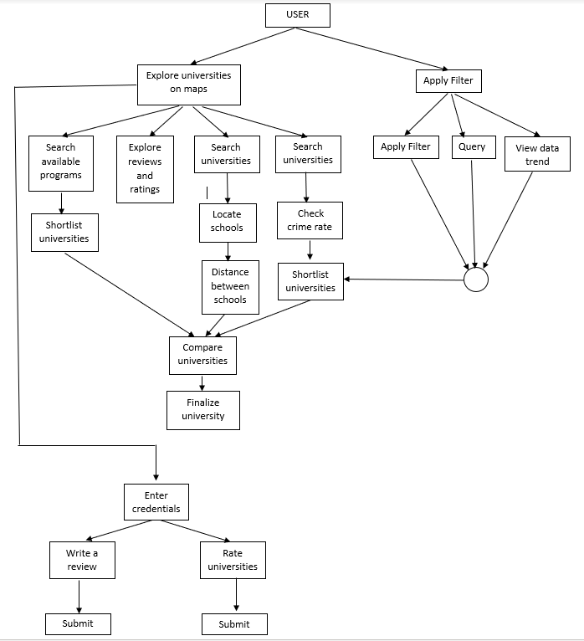
State diagram:

Slide 5
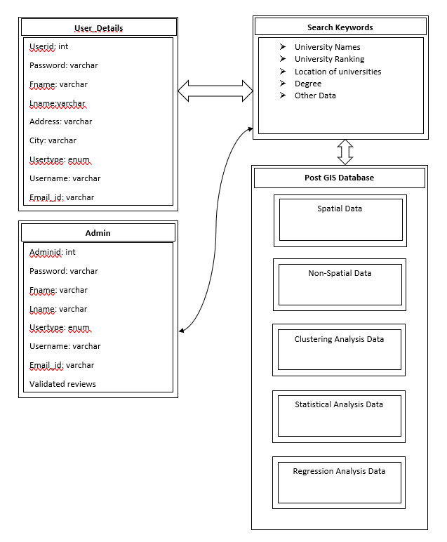
Database Design

Slide 6
Element or value | Data Type | Character Length | Acceptable Values
Userid | int | 10 | Y
Password | varchar | 20 | Y
Fname | varchar | 50 | Y
Lname | varchar | 50 | Y
Address | varchar | 200 | Y
City | varchar | 50 | Y
Usertype | enum | 50 | Y
Username | varchar | 50 | Y
Email_id | Varchar | 50 | Y
Reviews | varchar | 500 | Y

Slide 7
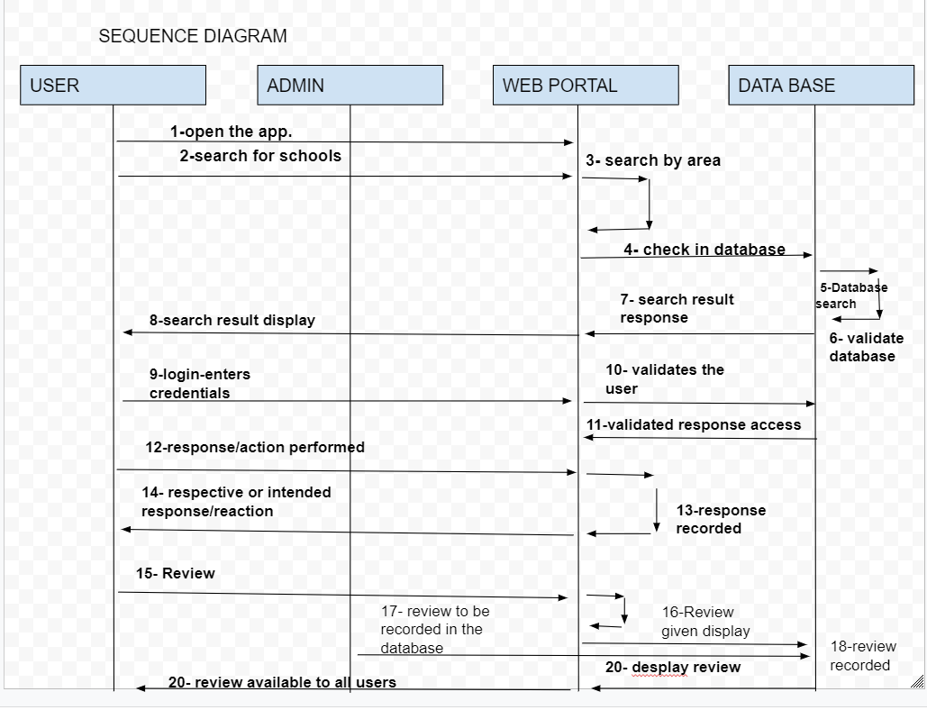

Slide 8
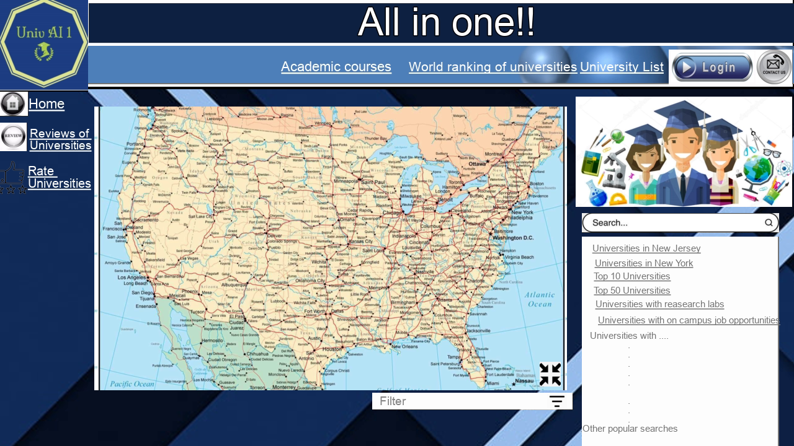
Interface diagram

Slide 9
Tools :
MS Word
Lucid App
Kapwing Website
Knowledge :
Unified Modeling Language
GIS System design
Academic system in the US

Slide 10
Lessons learnt so far while implementing WBS tasks scheduling, risks and communication:
Scheduling meeting and communicating with different schedules of teammates
Sticking to the timeline
Coding was difficult within the timeline so adapted the changes in scope (from coding to designing the website
Zoom Meetings for communication

Slide 11

Thanks!

